Slide 1




Data Analysis Project
Asthma Disease Insights
&
Predictive Analytics

Slide 2
Project Content
Idea & Problem
Python & ML
How To Fix
Dashboards
Data Source
Key Insights

Slide 3

The Idea & The Problem
Fragmented Data
Reactive, Not Proactive
No Interactive View
🌐
⏱
📊
Clinicians respond after attacks happen; predictive tools that flag high-risk patients early are rare.
GBD, WHO, CDC & national registries scattered across sources — no unified analytical platform.
304,776 rows across 204 countries existed only as a raw CSV — unusable for non-technical stakeholders.
Egypt Underrepresented
No AI Integration
Severe Class Imbalance
🇪🇬
🤖
⚖️
5.2% national prevalence & 26.5% pediatric burden are underreported vs. Western datasets.
No tool combined epidemiology + patient ML + a conversational assistant together.
Only 5.2% of the 2,392-patient dataset is diagnosed — standard models miss real cases.
2

Slide 4
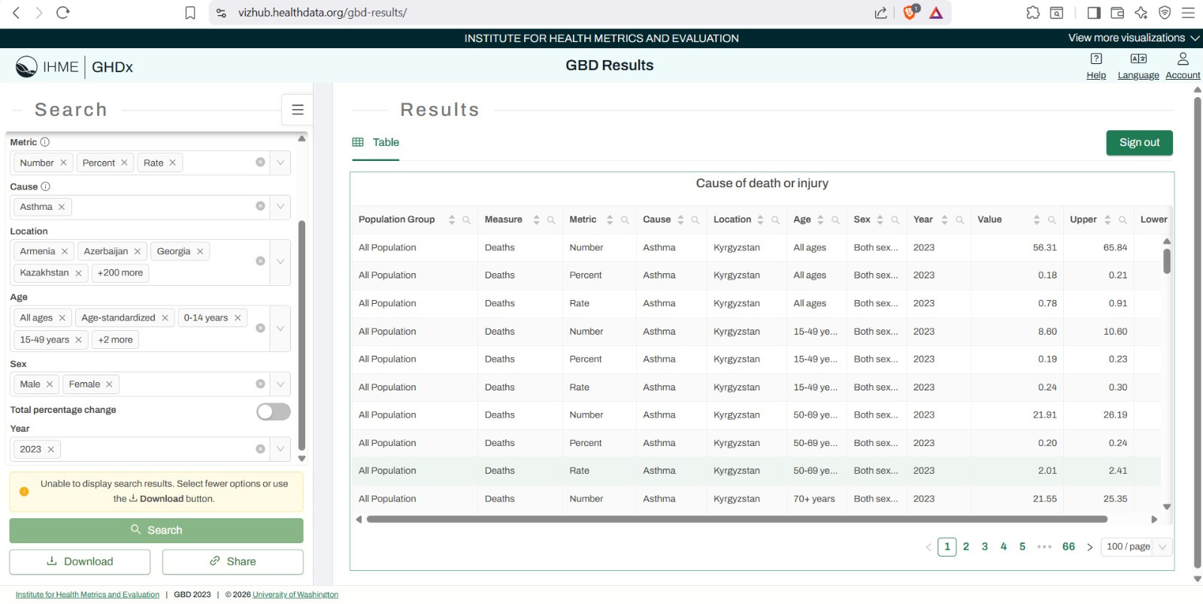
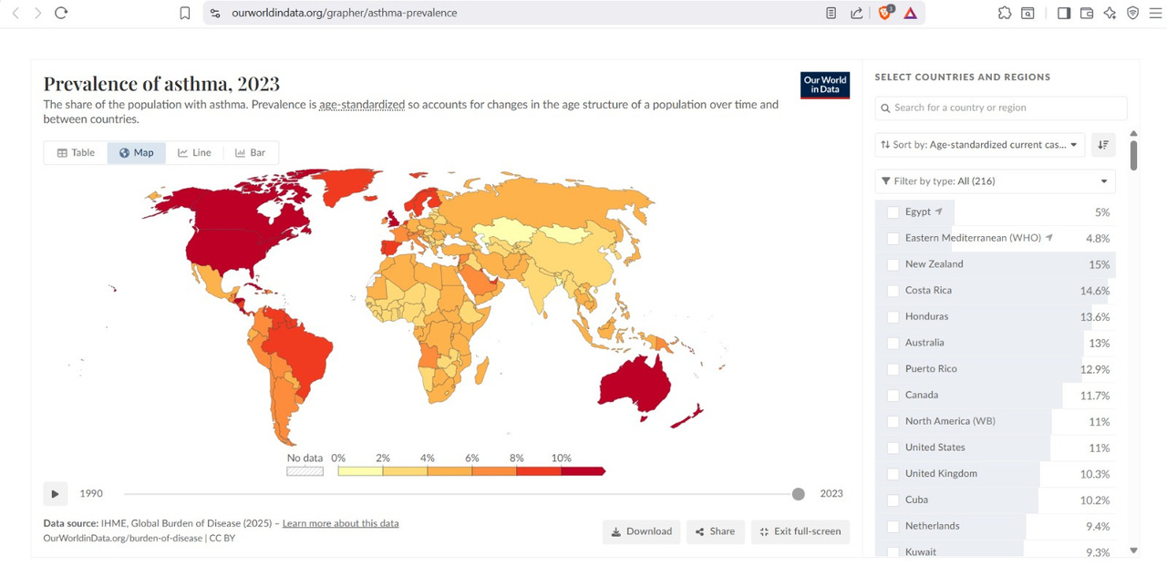

Data Source
1. Global & Regional Insights
IHME - Global Burden of Disease (GBD): Source for macro-level healthcare metrics and regional asthma prevalence trends.
Our World in Data: Utilized for spatial mapping, historical disease tracking, and global comparison dashboards.

Slide 5
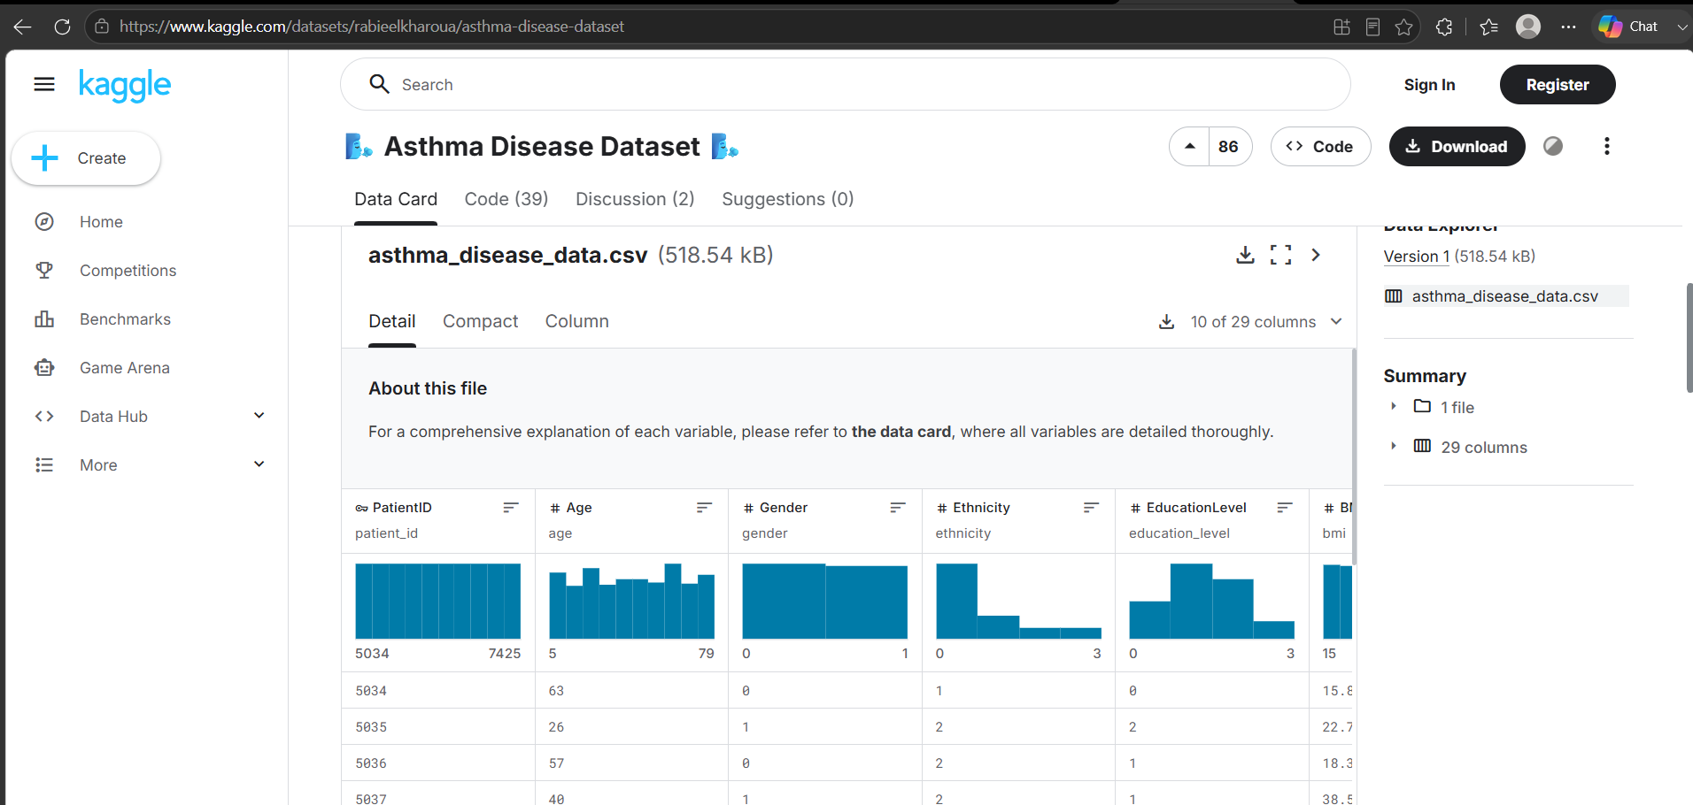
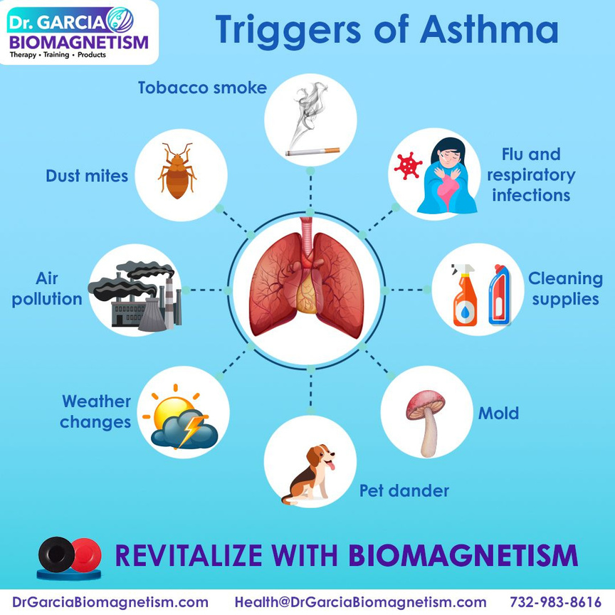
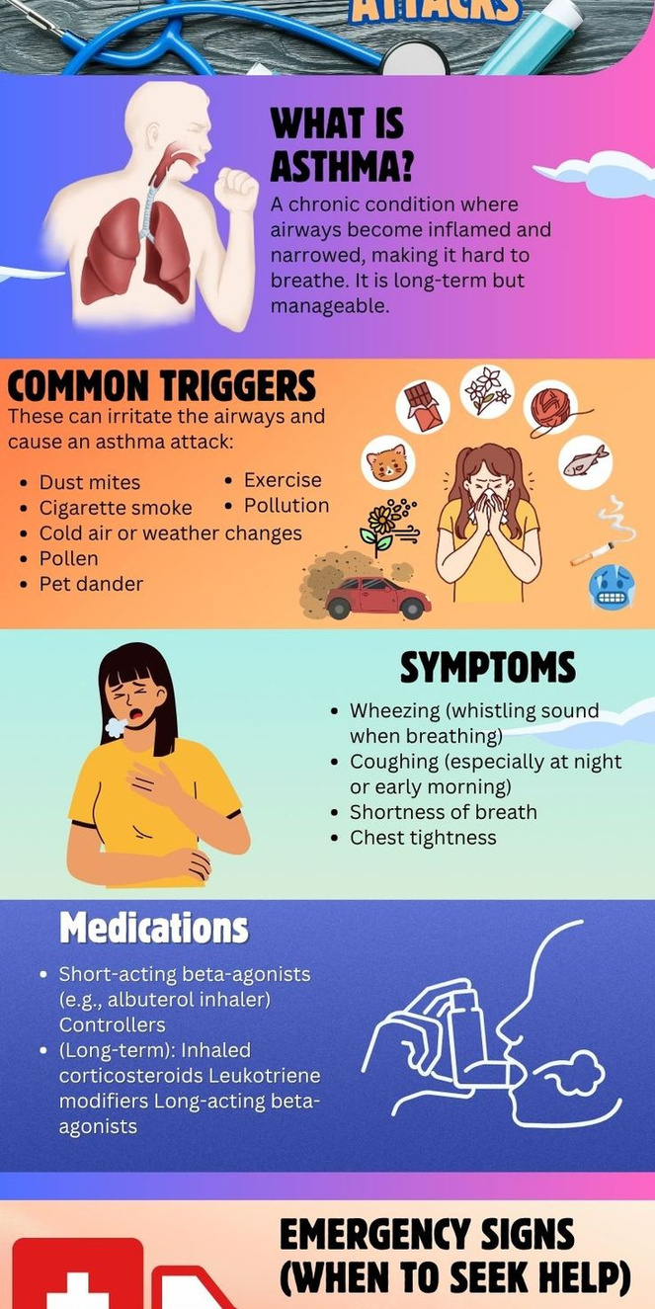
Data Source
2. Patient-Level Clinical Data
Original Source: Kaggle Asthma Disease Dataset (2,392 patient records, 29 clinical & lifestyle features).
Data Refinement & Balancing :
Class Imbalance Resolution: Handled severe class imbalance to secure an unbiased distribution (51% Healthy vs 49% Asthma) for robust machine learning training.
Logical Validation: Cleansed inconsistencies and illogical values in the original records to output a refined, realistic dataset (asthma_disease_data_realistic.csv).

Slide 6







Project Overview & Objectives
The Healthcare Challenge:
Asthma is one of the most widespread chronic respiratory diseases globally, posing a major challenge for early prediction, clinical management, and tracking prevalence variations caused by environmental, lifestyle, and genetic factors.
Key Project Objectives:
Macro-Level Analysis (Global Trends): Study and track global and regional asthma prevalence, evaluating historical and geographical evolution across countries using WHO and GBD datasets.
Patient-Level Prediction (AI & ML): Build a highly robust Machine Learning model capable of predicting accurate patient diagnosis based on clinical, environmental, and lifestyle metrics.
Comprehensive Solutions (End-to-End Hub): Deliver an interactive, multi-tool reporting ecosystem (Dashboards) optimized for healthcare administrators and clinical decision-makers at all levels.

Slide 7

Data Brief &
Features Spectrum
1. Global Asthma Prevalence Dataset:
Sources: IHME - GBD Results Tool and Our World in Data.
Content: Aggregated metrics mapped across countries (location_name), years (year), age groups (age_name), and gender (sex_name).
2. Clinical Patient Dataset:
Source: Originally sourced from Kaggle and optimized into our refined dataset (asthma_disease_data_realistic.csv).
Data Dimensions: Contains 2,392 patient profiles and 29 comprehensive features.
Key Features Breakdown:
Demographics & Lifestyle: Age, Gender, BMI, Smoking status, Diet quality, Sleep quality, and Physical activity.
Environmental & Hereditary Risks: Pollution exposure, Dust exposure, Pollen exposure, Family history of asthma, and Pet allergies.
Clinical Lung Function Metrics: Forced Expiratory Volume (LungFunctionFEV1) and Forced Vital Capacity (LungFunctionFVC).
Current Symptoms: Wheezing, Shortness of breath, Chest tightness, Coughing, and Nighttime symptoms.
Target Variable: Final clinical Diagnosis (Healthy vs. Asthma).

Slide 8




Primary Clinic
1️⃣ Python & Machine Learning
📌 Slide Title:
Section I: Python & Machine Learning
📝 Slide Content:
Exploratory Data Analysis (EDA)
Predictive Modeling (XGBoost)
Interactive Web Application (Streamlit)

Slide 9

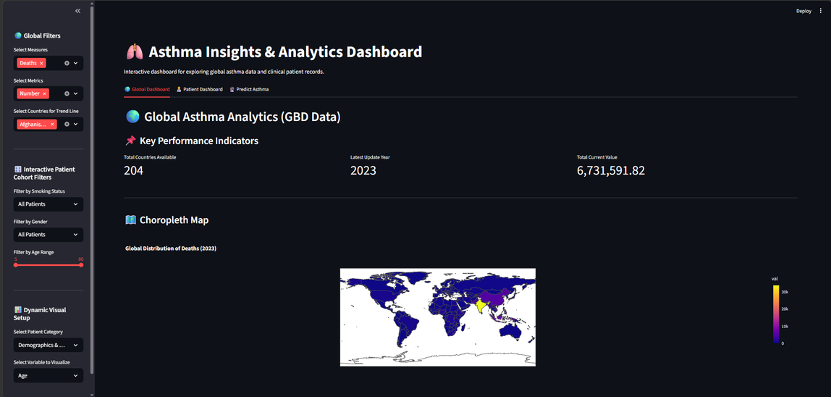
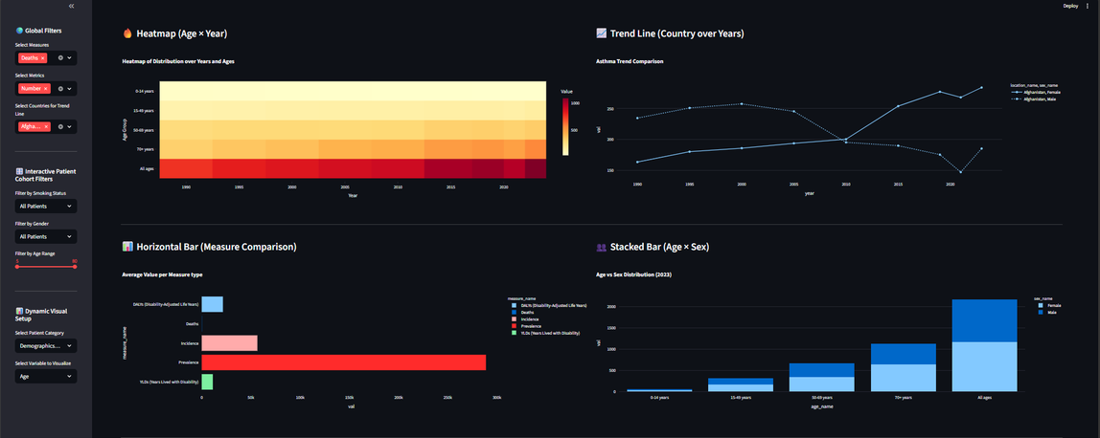
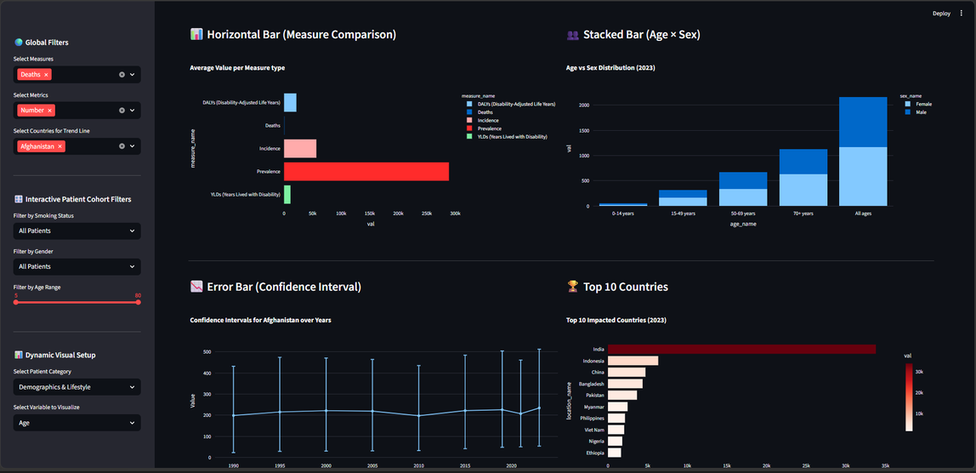
Streamlit Hub - Page 1:
Global Asthma Analytics
Objective: Mapping and visualizing global macro-level healthcare metrics and geographical asthma trends.
Core Functionalities:
Dynamic Global Filtering: Interactive sidebar to filter insights by measures, metrics, gender, and selected countries.
Global Choropleth Map: Heat-mapped world view visualizing the international distribution and impact of asthma.
Multi-Dimensional Analytics:
Age × Year Heatmap: Tracking disease weight across timelines and generations.
Stacked & Horizontal Bar Charts: Detailed demographic breakdown (Age vs. Sex) and measurement comparisons.
Statistical Reliability: Incorporates Confidence Intervals (Upper/Lower boundaries via Error Bars) to evaluate data certainty.

Slide 10
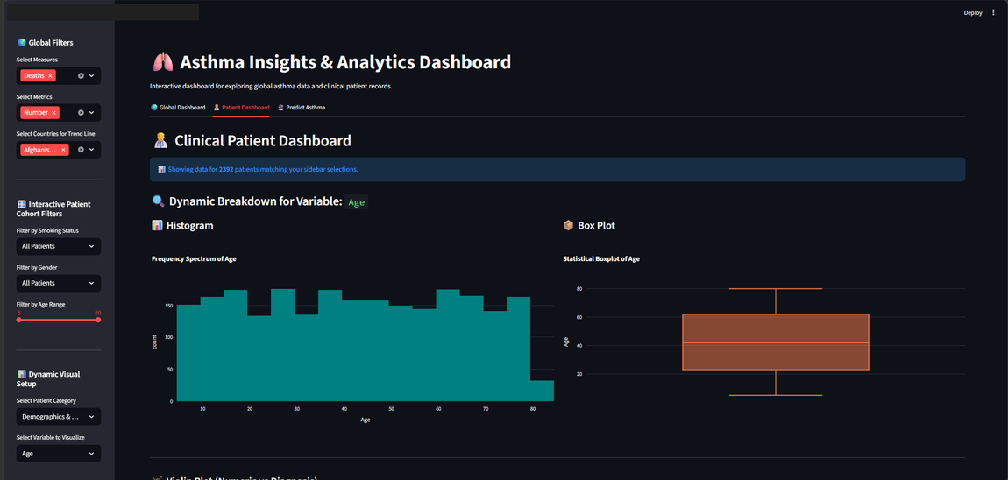
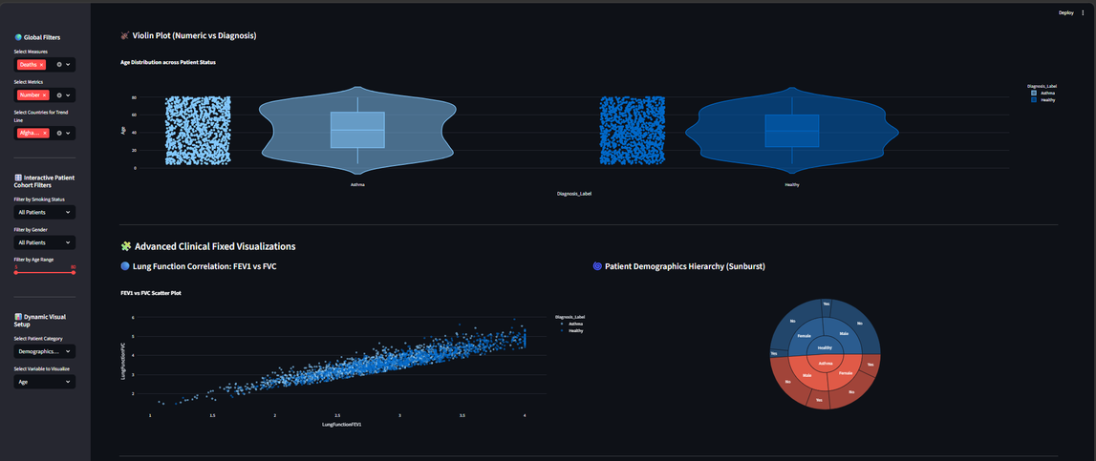
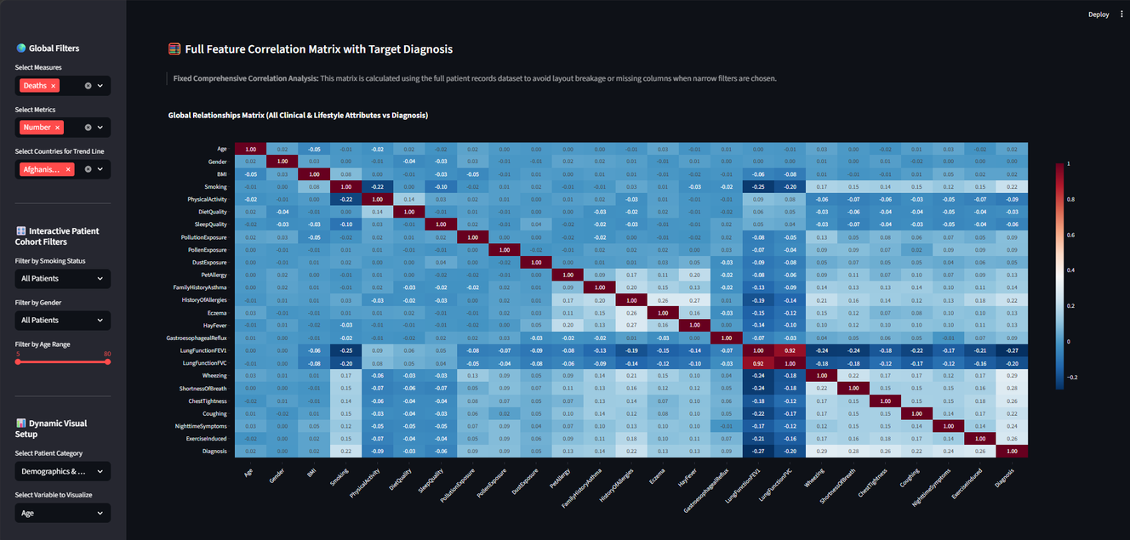
Streamlit Hub - Page 2: Clinical Patient Dashboard
Objective: Providing exploratory data analysis (EDA) and drill-down insights into patient-level clinical records.
Core Functionalities:
Cohort Selection: Interactive filtering based on Smoking status, Gender, and customizable Age ranges to segment patient cohorts.
Dynamic Visual Switching: Enables users to select any specific variable (from Demographics, Symptoms, or Medical History) to generate instant tailored charts.
Advanced Distribution Metrics: Features dynamic Donut charts, 100% Stacked bars (Variable vs. Diagnosis), Histograms, and Box/Violin plots.
Clinical Scatter Plots: Mapping the direct relationship between critical lung functions (LungFunctionFEV1 vs. LungFunctionFVC) color-coded by final diagnosis.
Full Feature Spearman Correlation Matrix: A comprehensive matrix plot highlighting linear and non-linear relationships between all 29 lifestyle/clinical attributes and the target diagnosis.

Slide 11
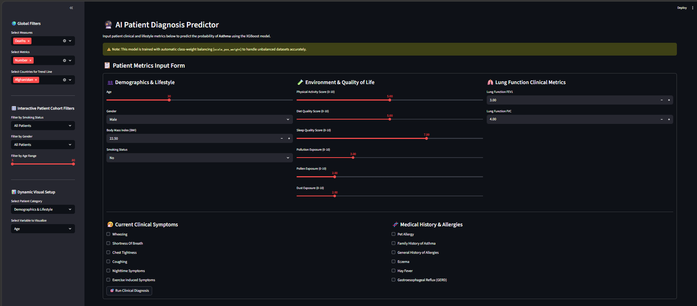



Streamlit Hub - Page 2: Clinical Patient Dashboard
Objective: Deploying the trained XGBoost machine learning model into a user-friendly, real-time clinical tool.
Core Functionalities:
Comprehensive Metrics Input Form: Organized 3-column input layout allowing clinicians to input custom patient data:
Demographics & Lifestyle: Age, BMI, Smoking status.
Environment & Quality of Life: Scores for Pollution, Dust, Pollen, Sleep, and Diet quality.
Clinical Systems & History: Medical history toggles (GERD, Allergies, Eczema) and specific lung functions.
Imbalance-Aware Prediction Engine: Utilizes our optimized XGBoost model equipped with scale_pos_weight to ensure reliable classifications.
Instant Diagnostic Output: Generates immediate binary classification (Positive Case Detected vs. Healthy Patient) accompanied by a model probability/confidence progress bar.

Slide 12
Dashboards & Data Ecosystem
📗
📈
🖥
🗄
Excel
Power BI
Tableau
SQL Layer
3 sheets · 6 KPI cards · 8 charts
3 pages · 8 DAX measures · 6 slicers
16 sheets · 9 dashboards · story points
Structured schema linking GBD + patient tables
5

Slide 13
Primary Clinic
Excel Section
📌 Slide Title:
Section II: Dynamic Analytics via Excel
📝 Slide Content:
High-Level Executive KPI Cards
Geographic Mapping & Longitudinal Trends (1990–2023)
Regional Demographic Drill-downs & Dynamic Slicers

Slide 14
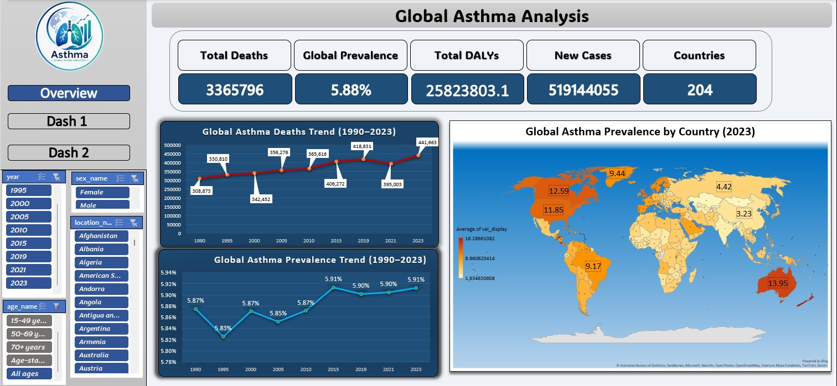
Excel Overview
Objective: summary of level global health metrics and geographic distributions.
Core Functionalities & Visuals:
Key Performance Indicators (KPIs)
Geographical Choropleth Mapping Study Prevlance in 2023
Dynamic Interactive Slicers: A dedicated filter panel enabling users to seamlessly isolate and slice data by Year, Sex, Age Group, and Country name.

Slide 15
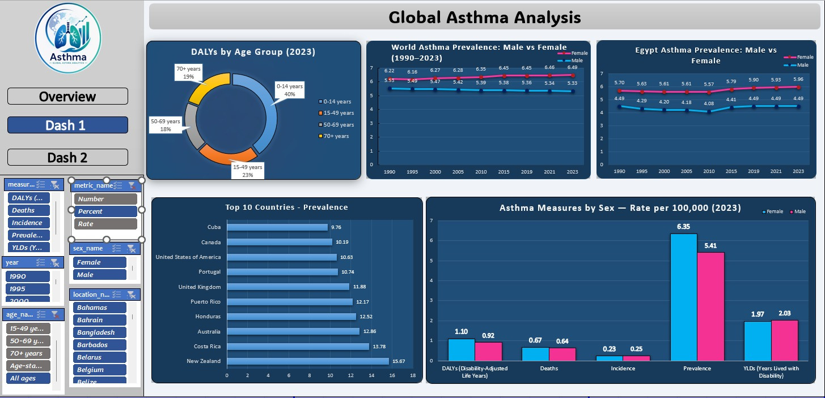
Excel Overview
Objective: Drillinng down into multi-dimensional data layers to evaluate age distributions, gender gaps, and specific regional metrics.
Core Functionalities & Visuals:
Age-Group Burden Distribution (DALYs 2023)
Gender Disparity Analysis (Male vs. Female Prevalence).
Localized Regional Tracking (Egypt Specific Case Study)
Top 10 High-Impact Countries
Standardized Rate Comparison Per 100,000 Population.

Slide 16
Primary Clinic
www.reallygreatsite.com
Power BI Section
📌 Slide Title:
Section III: Business Intelligence via Power BI
📝 Slide Content:
Strategic Executive KPI Cards
Demographic Dynamics & Spatial Mapping (Bing Maps)
Advanced Responsive Layouts & Intuitive Navigation (UI/UX)

Slide 17
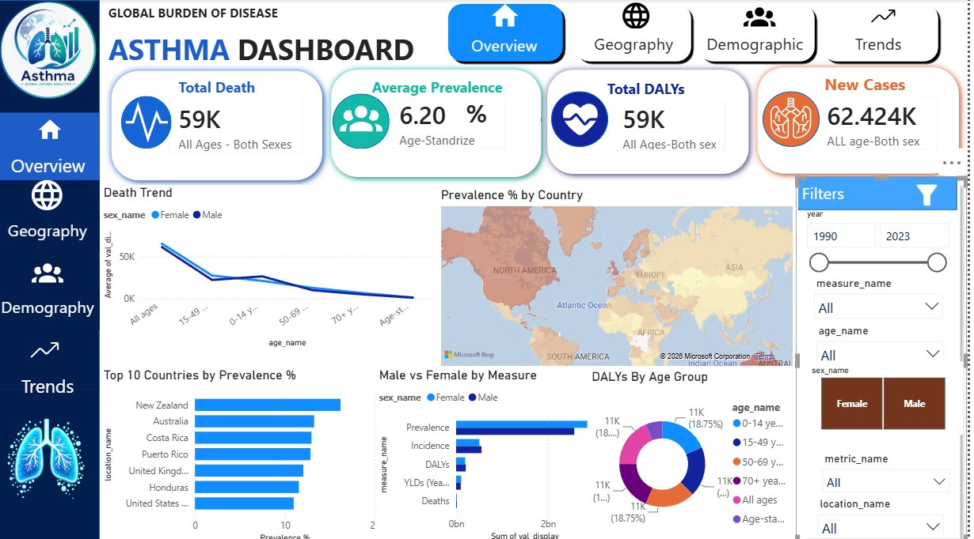
Power BI Hub - Enterprise Business Intelligence Platform
Objective: Delivering an integrated Business Intelligence solution connecting macro metrics with spatial and demographic analysis.
Key Visuals & Features:
Executive KPI Cards: Instant tracking of Total Deaths (59K), Average Prevalence (6.20%), and New Cases (62.4K).
Advanced UI: Seamless top and left navigation bars designed for easy executive dashboard switching.
Bing Maps Integration: Live geographic mapping layers to pinpoint global disease hotspots and density.
Demographic Analytics: Side-by-side charts comparing metrics between sexes and displaying DALYs distribution by age.
Unified Filter Pane: Dedicated interactive panel for instantaneous data slicing and deep drill-downs.

Slide 18
Primary Clinic
Tableau
📌 Slide Title:
Section III: Interactive Analytics via Tableau
📝 Slide Content:
C-Suite Executive KPI Grid
Longitudinal Risk & Heatmap Tracking
Statistical Deviation & Demographics: Automated Z-Score analysis identifying critical geographic outliers (e.g., Brazil

Slide 19
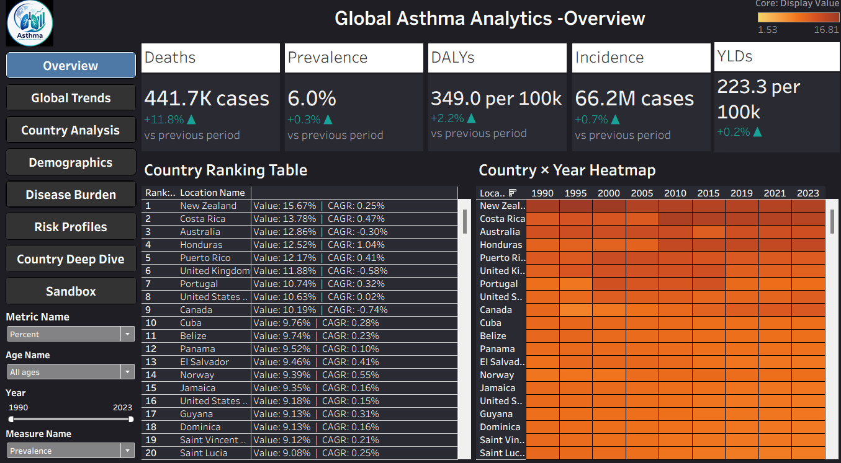
Tableau

Slide 20

Analytical Suite Implementation
Q4: Integration
Q2: Calculations
Completed global filter actions for seamless interactive sandbox exploration.
Formulated dynamic metrics, regional CAGRs, and Z-score outlier logic.
Q1: ETL Build
Q3: Dashboard
Cleaned and structured GBD global respiratory files from 1990–2023.
Designed a dark-themed left-nav sidebar dashboard system in Tableau.

Slide 21


Thank You
Ammar Abdelkabir
Mohamed Ahmed
Nour Ayman
Nancy Abdelnaby
Abdelrahman Mohamed
Adham Ahmed
hello@reallygreatsite.com
Link Rpo
The Story of Saving Lives with Numbers

